Slide 1
worship
(re) Making Memories

Slide 3
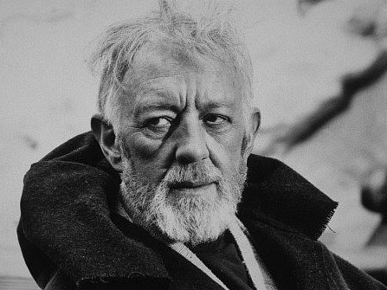

Slide 6
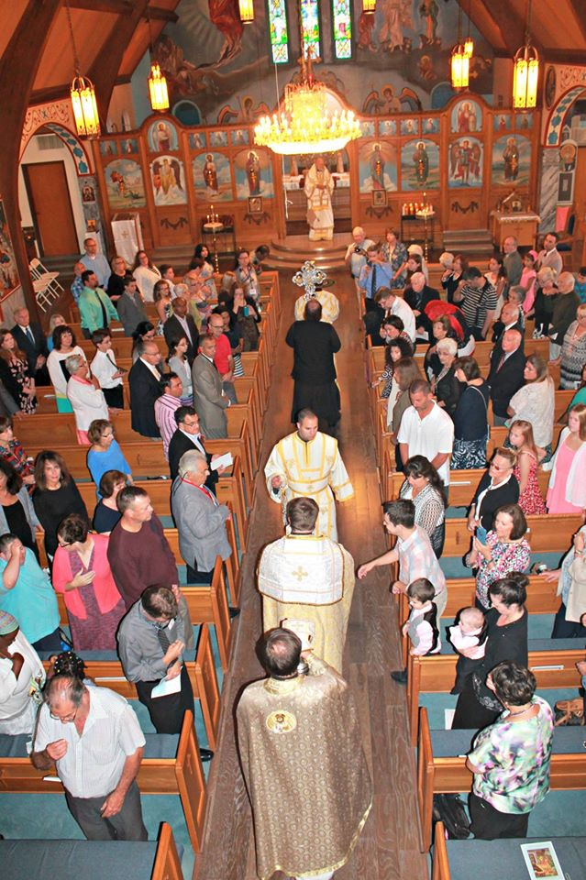
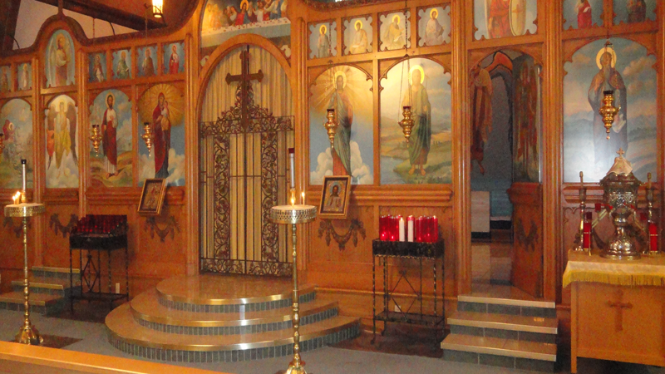
St. Thomas Orthodox Church Sioux City, Iowa

Slide 8
Spiritual Reality
Spiritual Reality
Porous Boundary
Temporal Reality
Temporal Reality

Slide 10
Liturgy: The Work
What do we gather to do?
Re-Member
Anamnesis
Make Present Again
Roman Catholic and Eastern Orthodox
Eucharist
Christ is Present in the Bishop (Priest)
Bread and the Wine
Protestant
Word (Gospel)
Christ is Present in the Proclamation of the Gospel

Slide 11
Eschatology and liturgy
Kairos=Eternal Time
Temporal Time

Slide 12
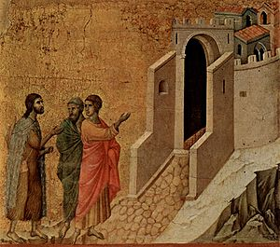
questions
How do our Liturgical Practices Shape Us?
Proclamation or Teaching Time?
Active or Passive?
Open or Closed? (Eschatological or Fatalistic?)
Deep (Mystery) or Thin (Hyper-Pragmatic)
What does our Worship say about our View of Reality?

